Slide 2
Live Pure is a Catholic pro-life youth movement that promotes and defends the culture of LIFE, by leading young people to a life of Purity and Chastity.

Slide 3
OBJECTIVES
To promote a Live Pure lifestyle among the youth today.
To bring the cause of Live Pure to Parishes, High Schools, Colleges and Universities through Live Pure formation sessions, workshops and events.
To start a world-wide movement enjoining young men and women standing and living up for the cause of chastity and purity.

Slide 4
VISION
We are a Catholic movement committed to a life of purity, leading young men and women in pursuit of life’s true meaning according to their destiny in Christ.
MISSION
We are pro-life advocates striving for purity of mind, eyes, speech and body. We commit to share our conviction by giving young people opportunities to realize and live out the value of human dignity and fraternal relationships.

Slide 5
BRIEF HISTORY OF THE MOVEMENT
2016
(October) Live Pure was invited to its first set of fora in the United States by St. Stephen’s Parish of Des Plaines, Illinois.
Three Fridays: Oct. 1, 15, 29
Around 60 participants (Ages 12-19)
Parent’s Forum: Oct. 23

Slide 7
I am created in God’s image and likeness; hence, I will live out His greatness and holiness by striving to imitate Christ and His purity.
I commit to practice the virtue of chastity and observe self-control over my passions and desires.

Slide 8
I WILL FREE MY MIND.
I will keep my mind clean from impure and lustful thoughts. I will keep my eyes away from pornography, as it degrades me.

Slide 9
I WILL SPEAK WITH GRACE.
My speech will be gracious at all times. I will not speak nor laugh at green jokes, nor share and listen to stories which evoke sexual thoughts and behaviors.

Slide 10
I WILL BE CHASTE.
I will treat my body for what it truly is – the temple of the Holy Spirit. I will not engage in masturbation, pre-marital sex or homosexual acts.

Slide 11
I WILL LOVE TRULY.
I WILL LOVE TRULY.
I will become a man/woman after God’s own heart, that I may learn to love purely. I will make a gift of myself in whichever vocation God will call me to. I will keep my relationships pure.

Slide 12
I am called to lead a chaste life,
whoever I am, whatever I do, whatever they say
and wherever I may be.
I will Live Pure.

Slide 13
CHASTITY FORUM. MEN’S & WOMEN’S FORUM. LOVE FORUM

Slide 14
CHASTITY FORUM.
1st stage of Live Pure series. Discusses human sexuality and how our sexuality works perfectly with God’s plan. Promotes the true value of sex and encourages young men and women to live a chaste life.
Running time: 2 hours
1st PHASE

Slide 15
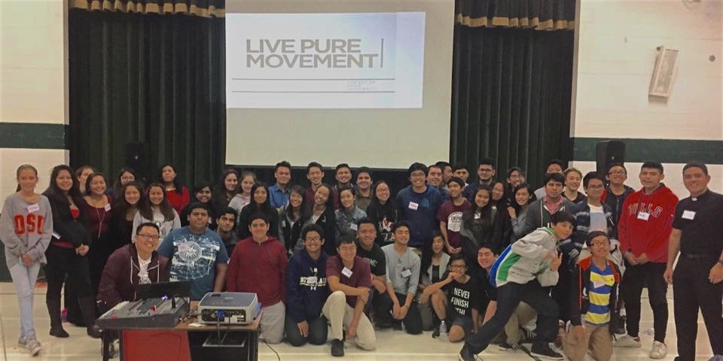
- CHASTITY FORUM, ST. STEPHEN’S PARISH-

Slide 16
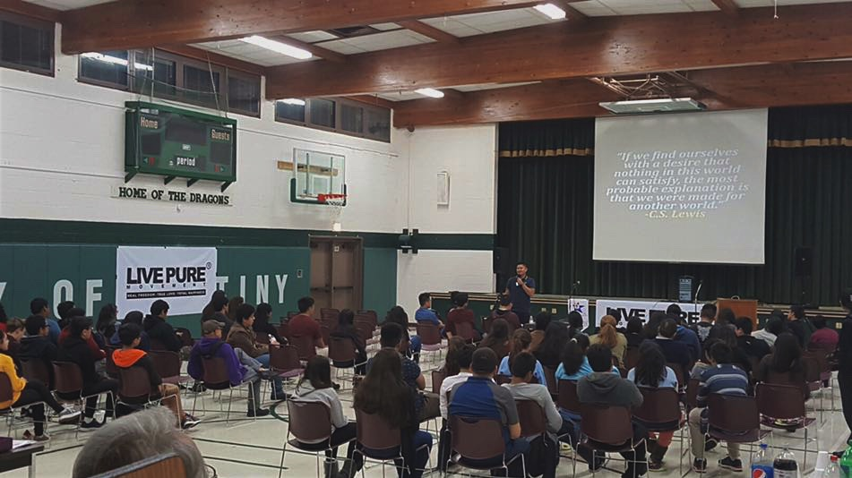
- CHASTITY FORUM, ST. STEPHEN’S PARISH-

Slide 17
MEN’S & WOMEN’S FORUM.
2nd stage of Live Pure series. Discusses the unique issues that men and women are going through and guides them how to become men and women after God’s own heart. Leading them to authentic manhood and womanhood.
Running time: 2 hours
1st PHASE

Slide 18
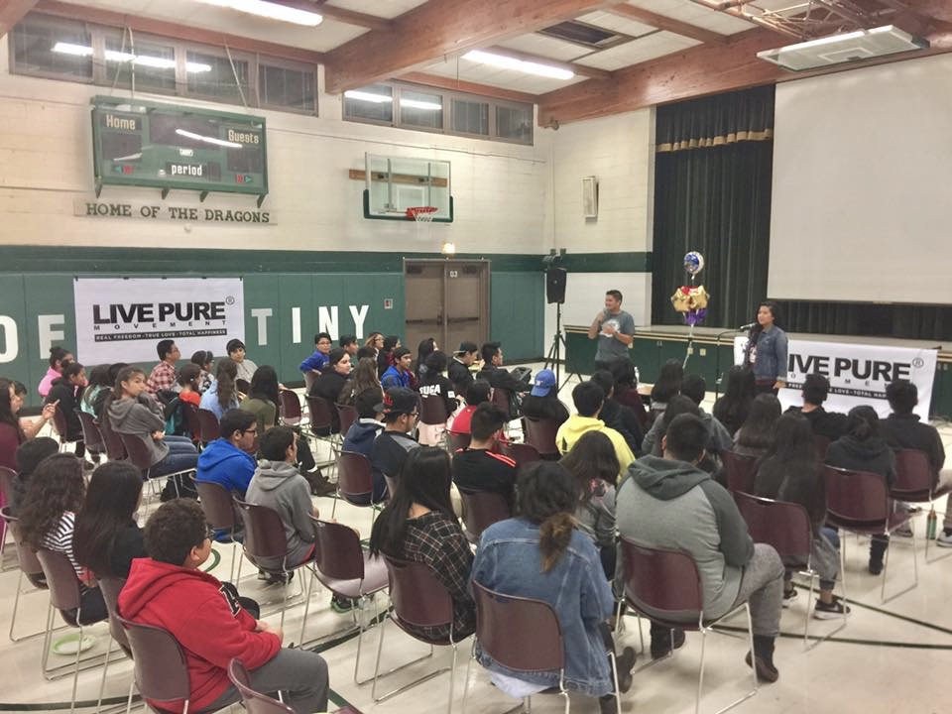
- MEN & WOMEN’S FORUM, ST. STEPHEN’S PARISH-

Slide 19
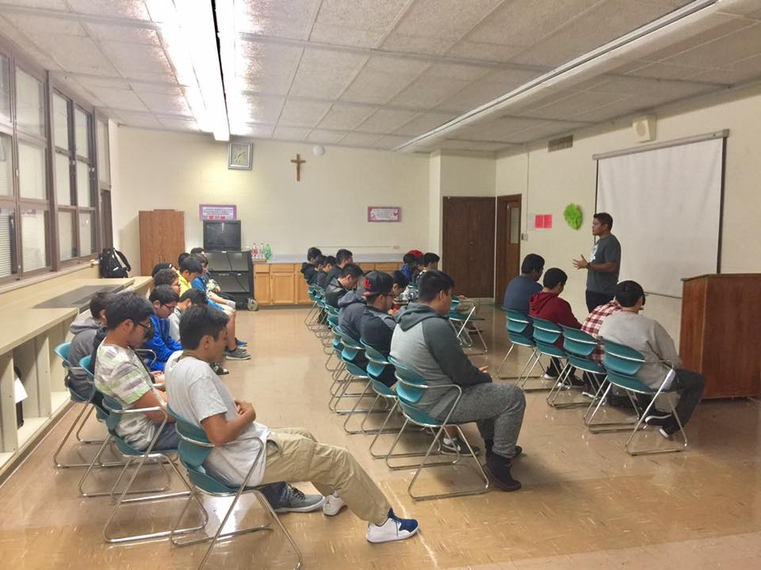
- MEN’S FORUM, ST. STEPHEN’S PARISH-

Slide 20
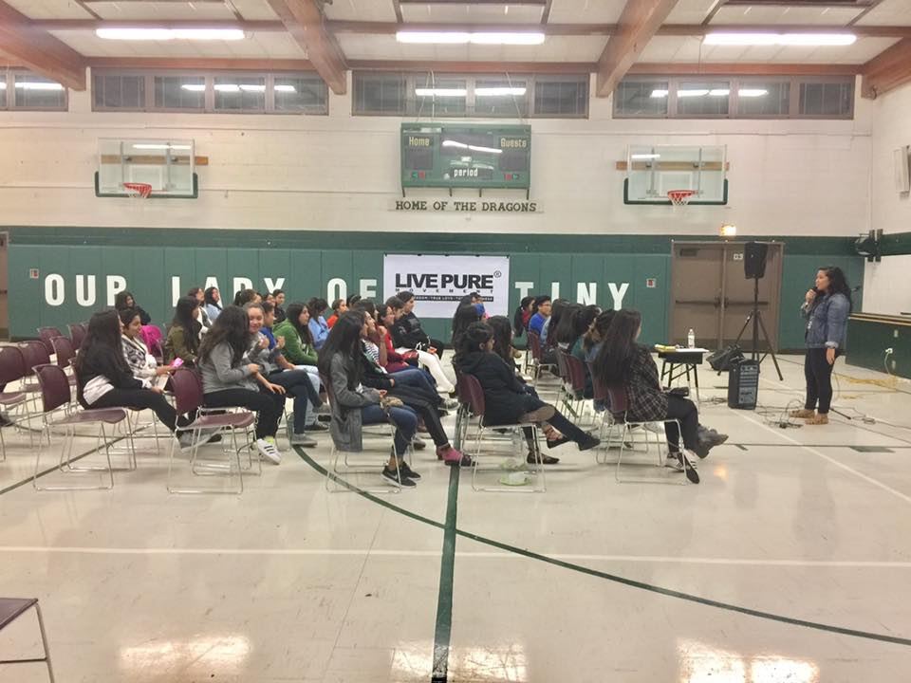
- WOMEN’S FORUM, ST. STEPHEN’S PARISH-

Slide 21
LOVE FORUM
3rd stage of Live Pure series. Leads the audience in discovering the value of true love and the importance of waiting for God’s perfect time. Makes everyone realize his/her capability for authentic love.
Running time: 2 hours
1st PHASE

Slide 22
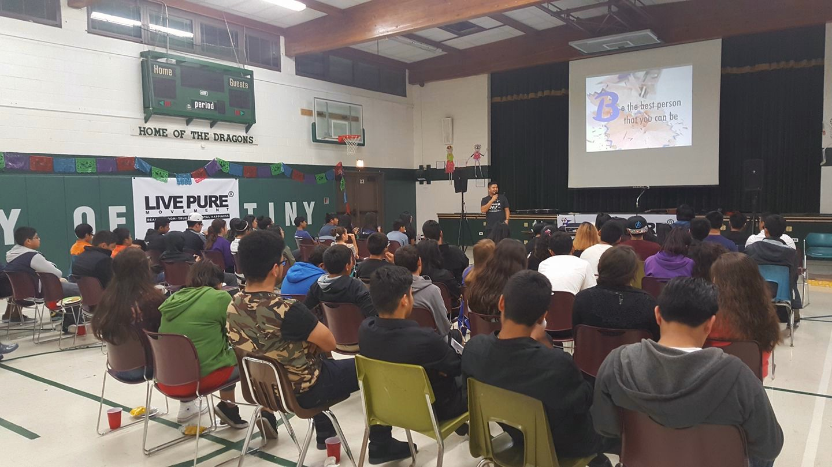
- LOVE FORUM, ST. STEPHEN’S PARISH-

Slide 23
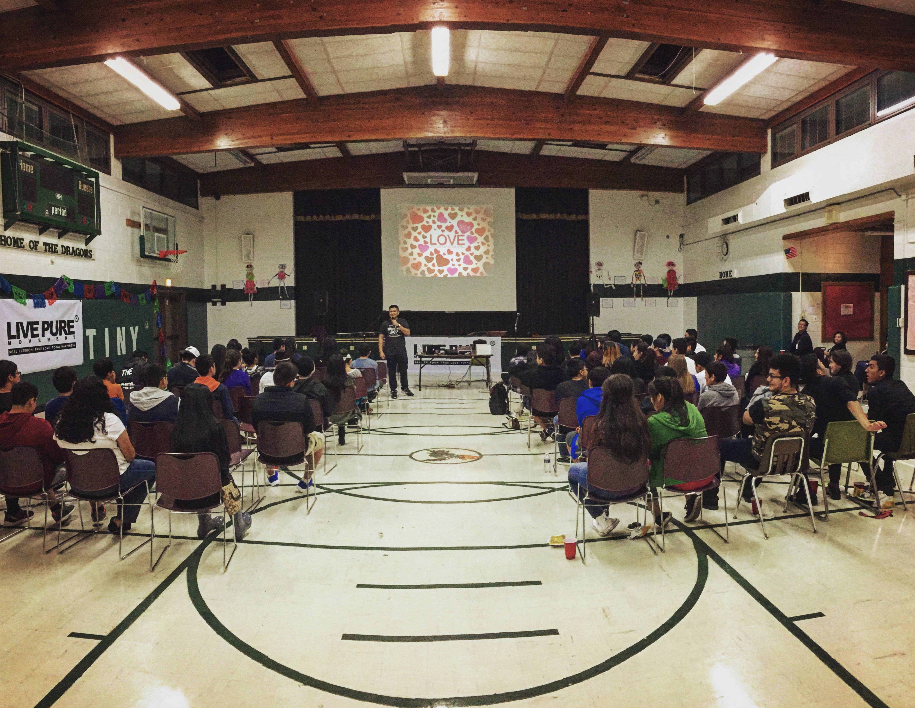
- LOVE FORUM, ST. STEPHEN’S PARISH-

Slide 24
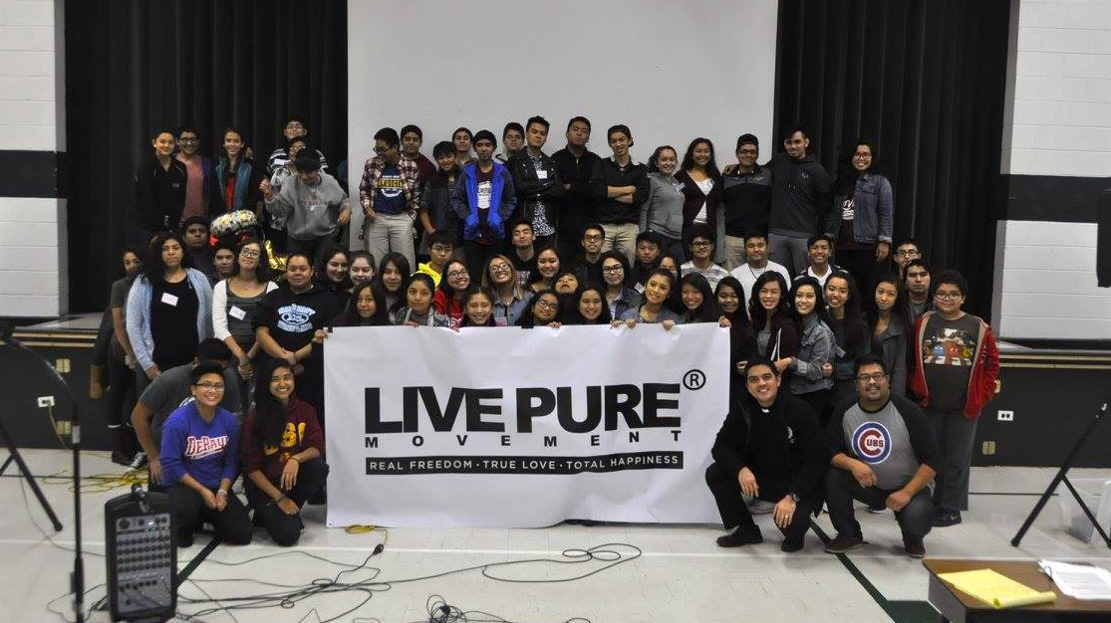
- LOVE FORUM, ST. STEPHEN’S PARISH-

Slide 25
PARENTS FORUM

Slide 26
PARENTS FORUM
This forum will make the parents embrace their fundamental role as the first educators of their children and help them in understanding the youth of today. This will also help the parents to learn the basics in educating children about love and sex through the virtue of Chastity.
Running Time: 2 hours

Slide 27
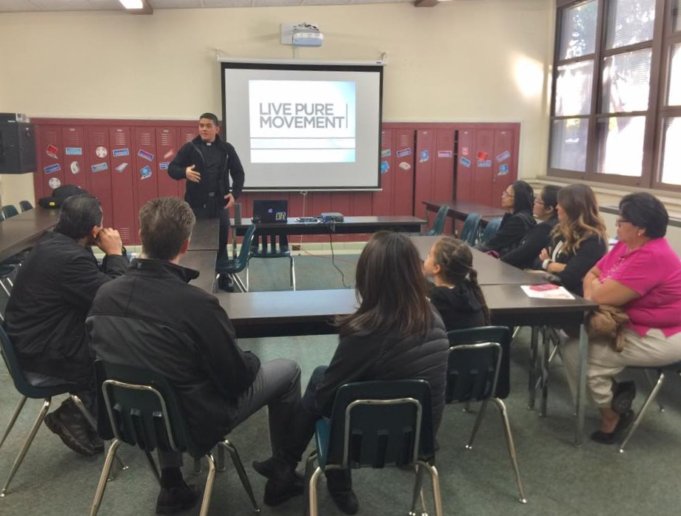
- PARENTS FORUM, ST. STEPHEN’S PARISH-

Slide 28
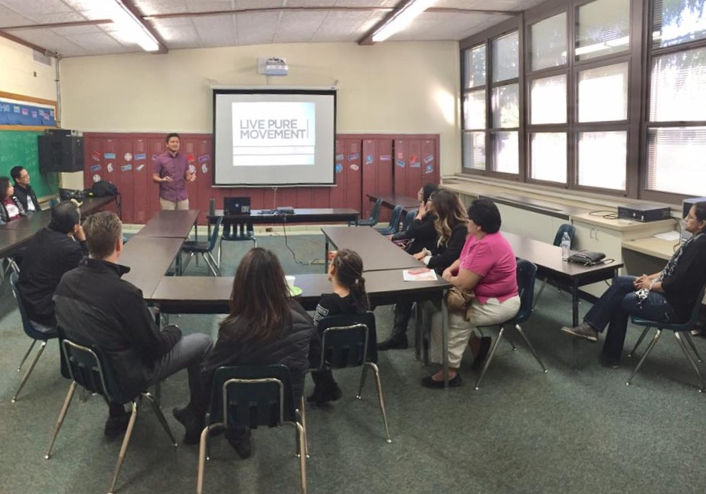
- PARENTS FORUM, ST. STEPHEN’S PARISH-

Slide 29
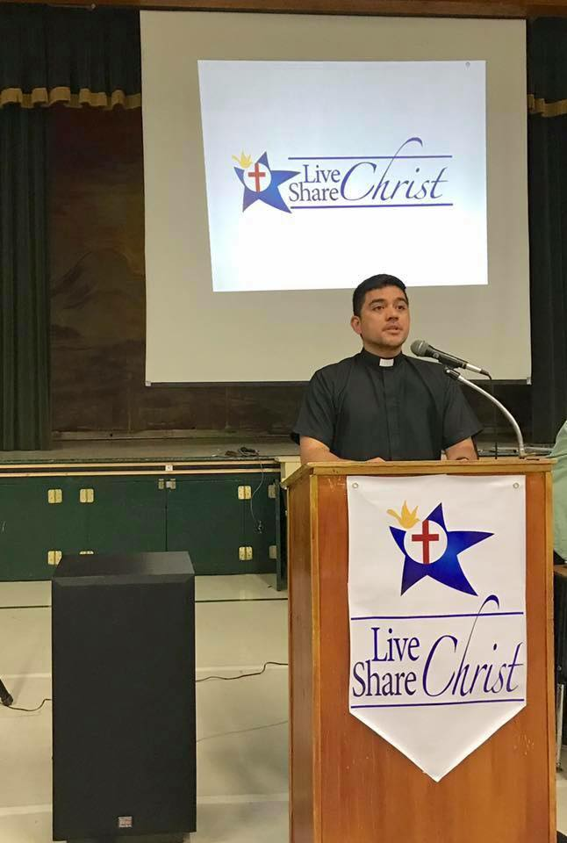
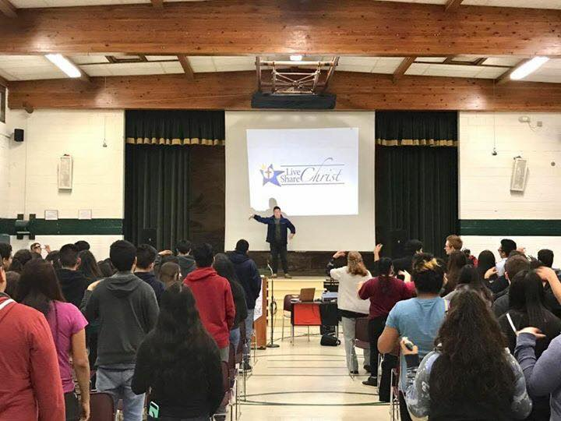
After a few months we offered
Live Christ Share Christ (LCSC) seminar

Slide 30
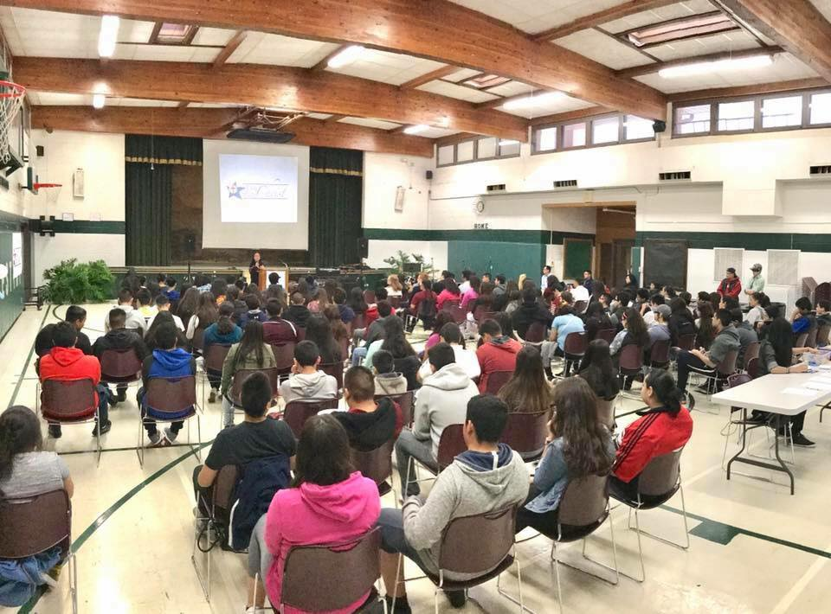
LCSC for Youth
St. Stephens Parish, Des Plaines, IL

