Slide 1


Slide 2


Slide 3
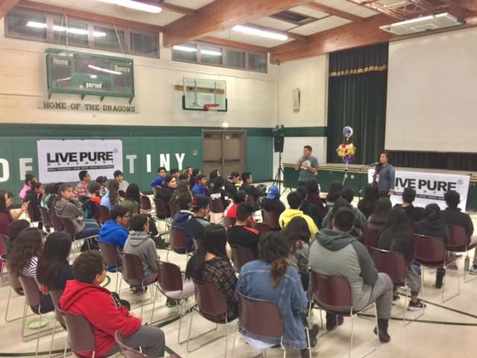
LIVE PURE – St. Stephens Parish
Des Plaines, IL

Slide 4
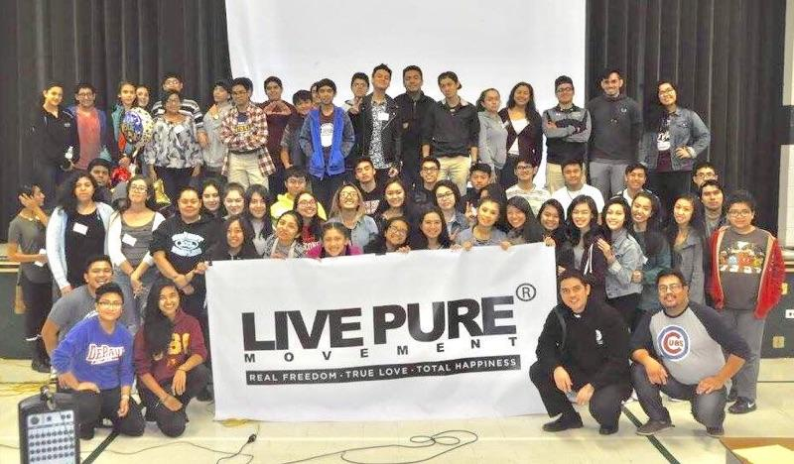
LIVE PURE – St. Stephens Parish
Des Plaines, IL

Slide 5
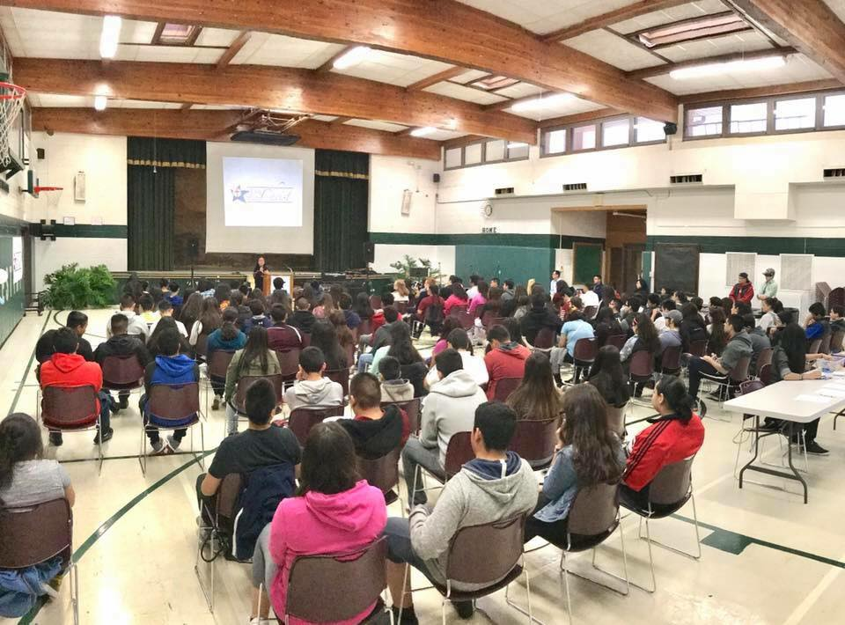
LCSC for Youth St. Stephens Parish
Des Plaines, IL

Slide 6
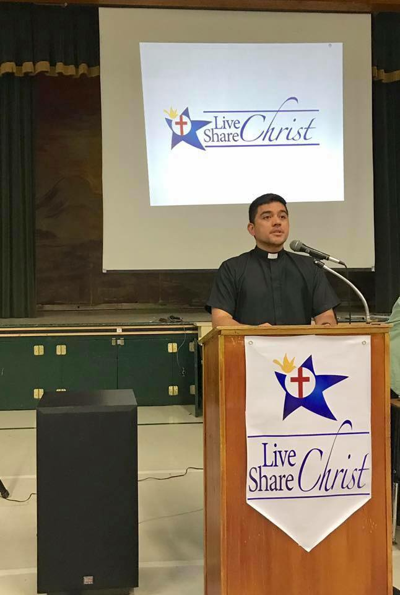
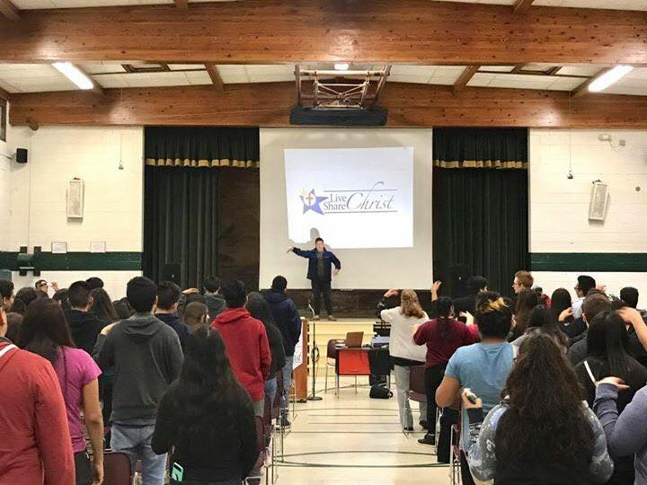
LCSC for Youth
Des Plaines, IL

Slide 7
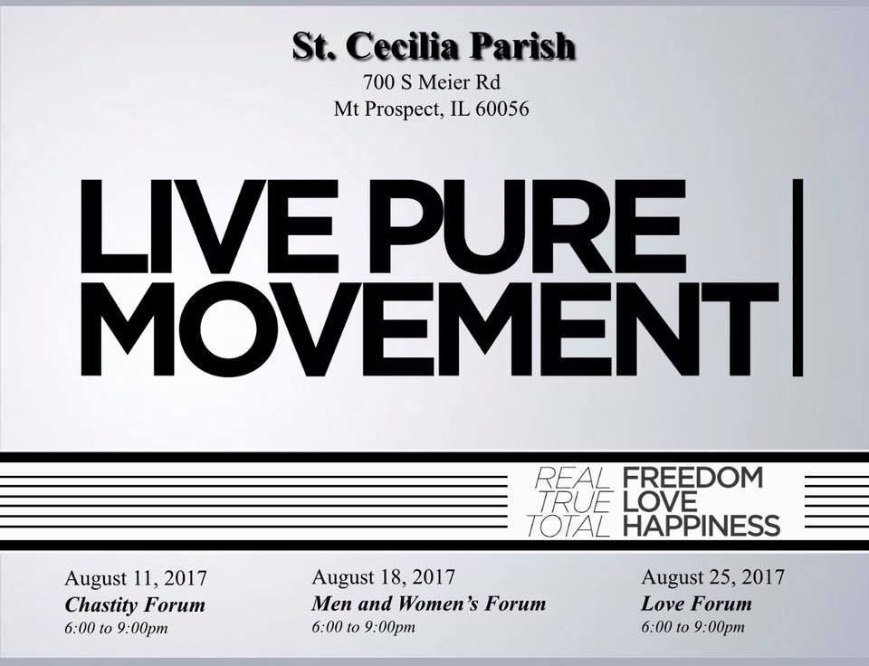

Slide 8
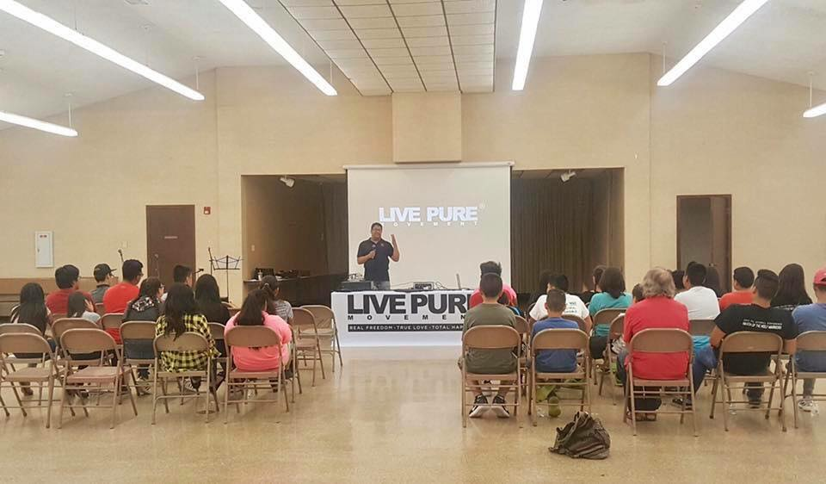
LIVE PURE at St. Cecilia Parish
Mt. Prospect, IL

Slide 9
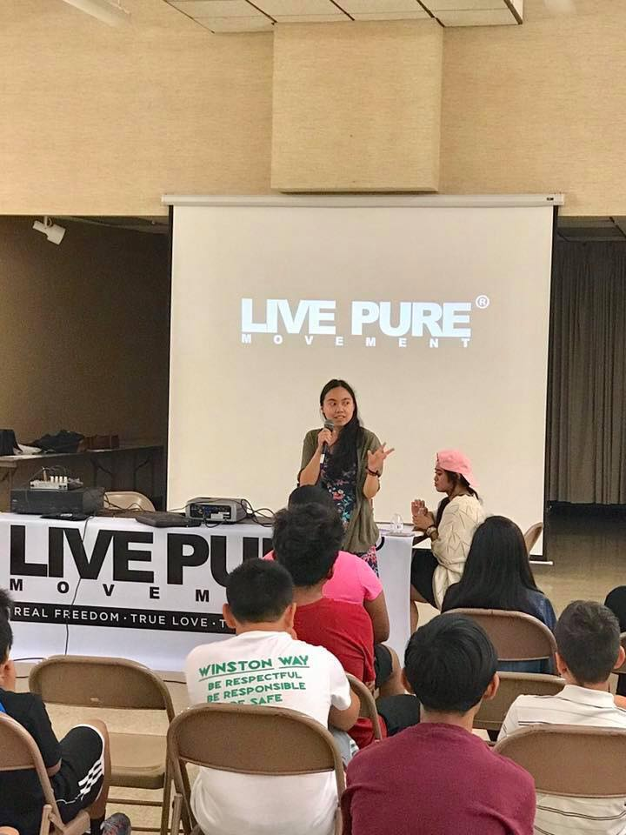
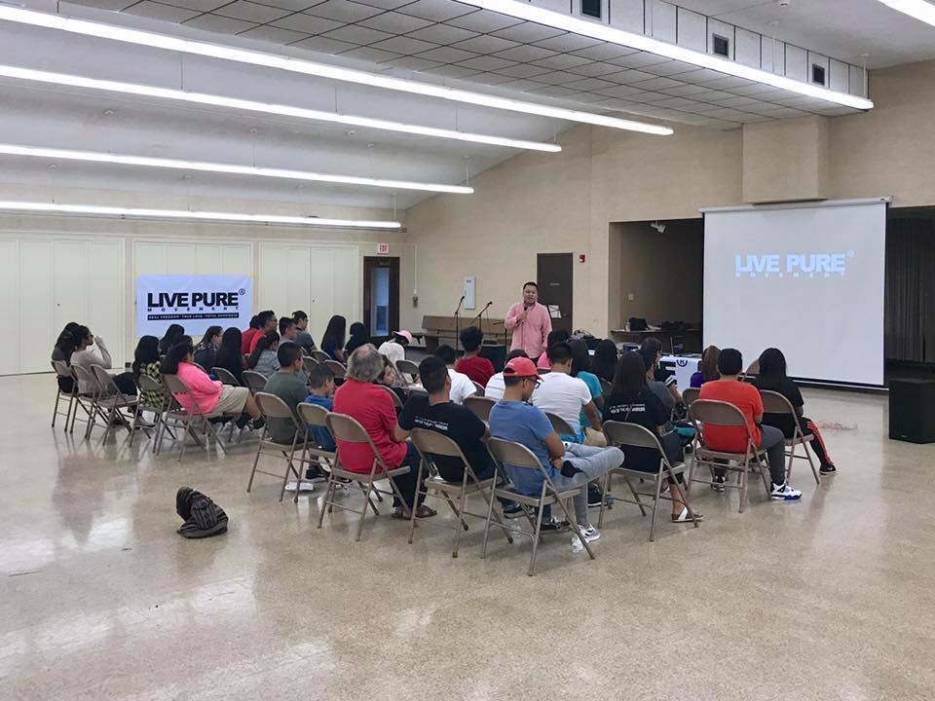
LIVE PURE at St. Cecilia Parish
Mt. Prospect, IL

Slide 10
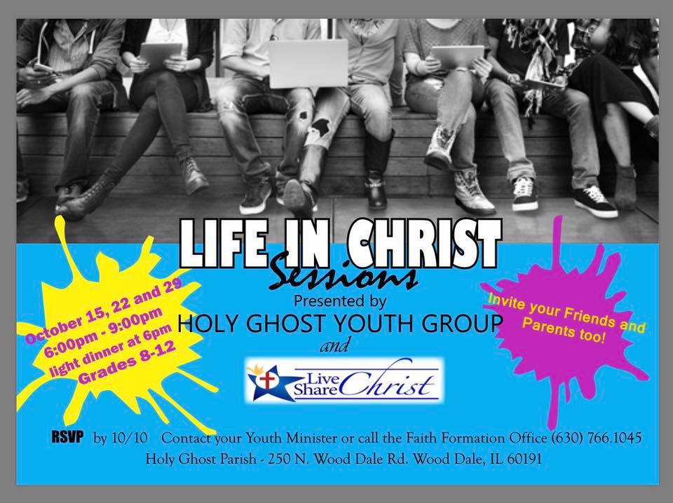

Slide 11
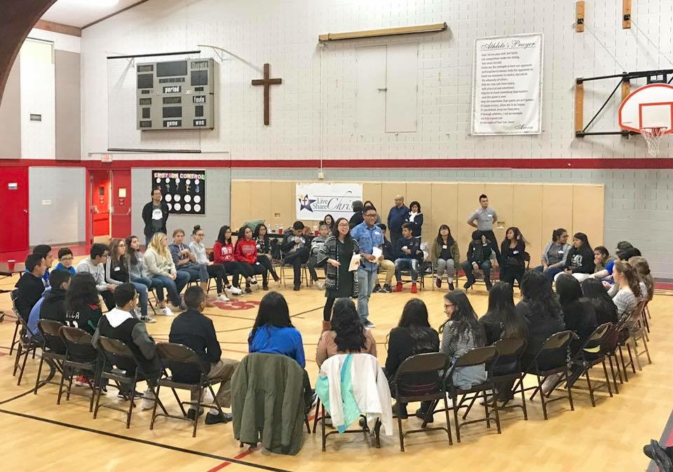
LCSC for Youth at Holy Ghost Parish
Wood Dale, IL

Slide 12
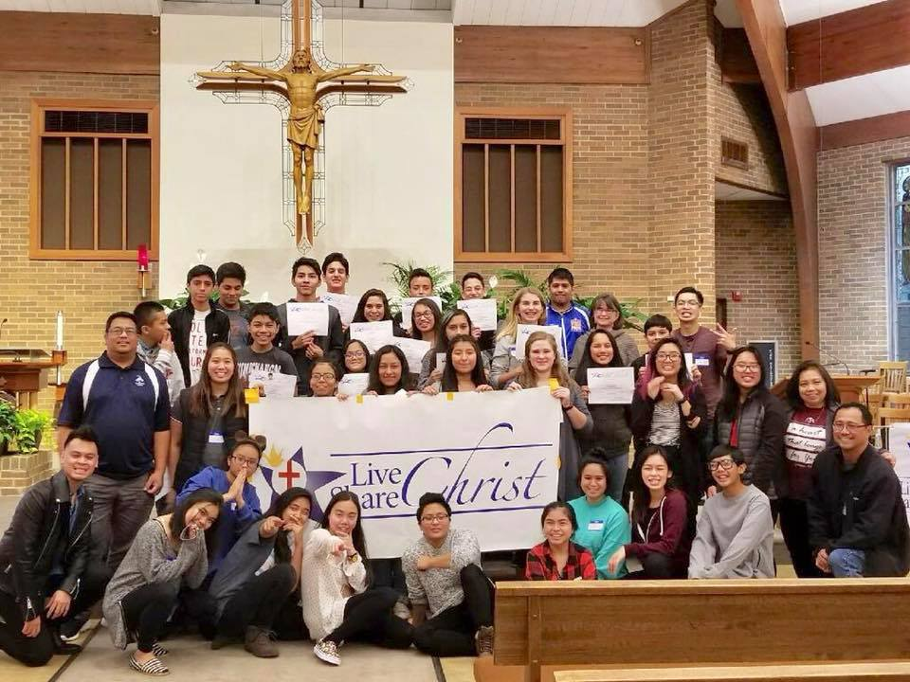
LCSC for Youth at Holy Ghost Parish
Wood Dale, IL

Slide 13
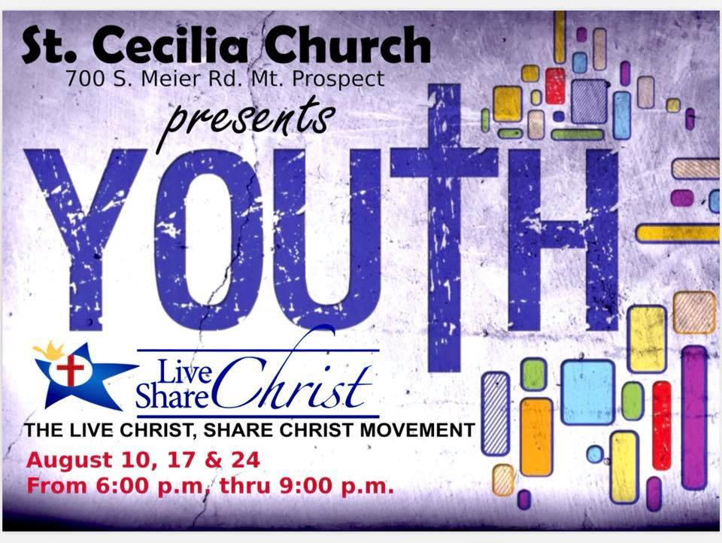

Slide 14
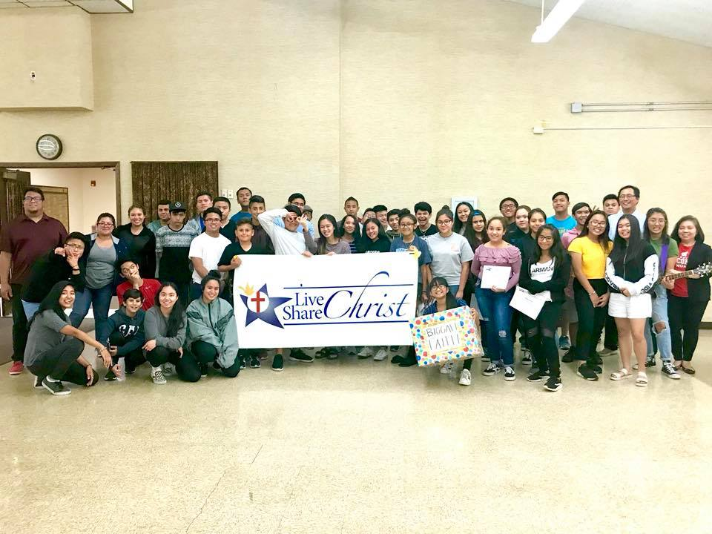
LCSC for Youth at St. Cecilia Parish
Mount Prospect, IL

Slide 15


Slide 16
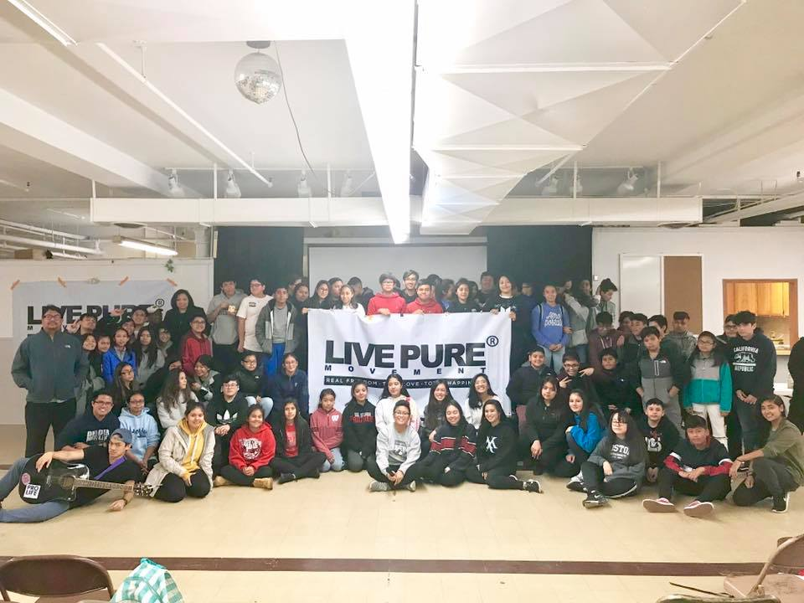
Live Pure for Youth at
Transfiguration Parish
Chicago, IL

Slide 17
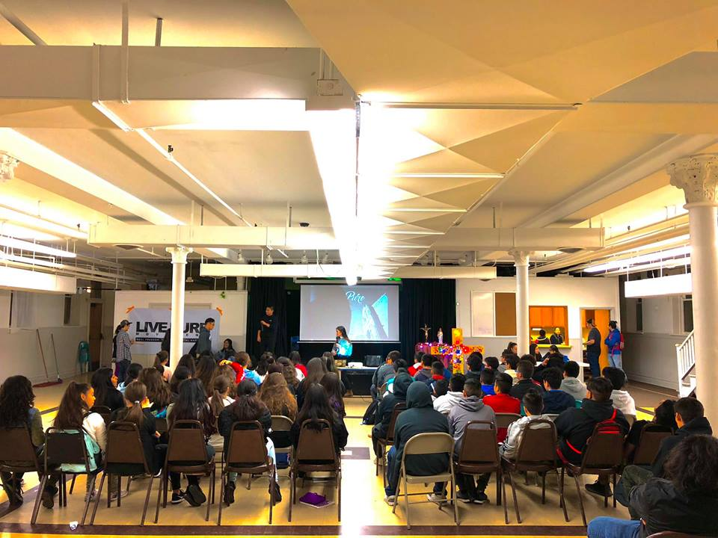
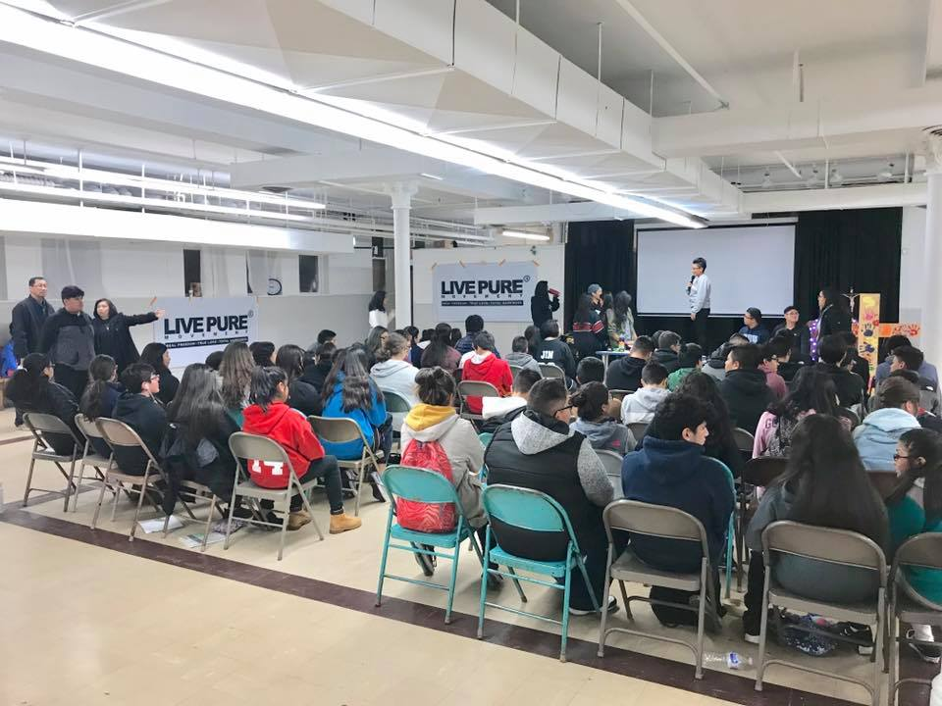
Live Pure for Youth at
Transfiguration Parish
Chicago, IL

Slide 18


Slide 19
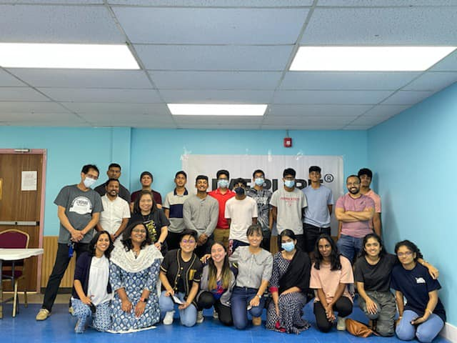
Live Pure at St. Thomas Syro Malabar
Belwood, IL

Slide 20
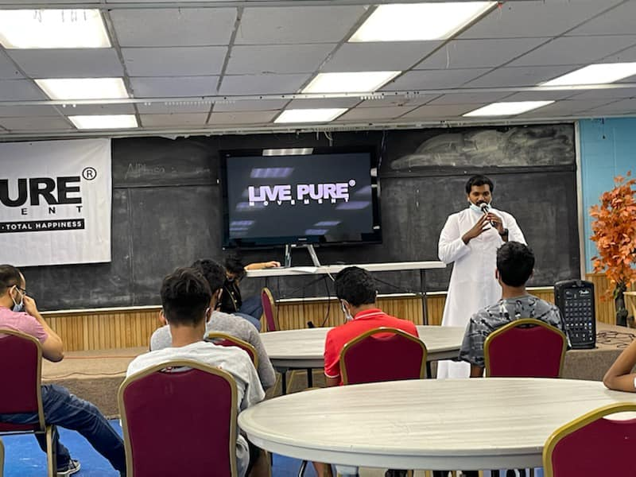
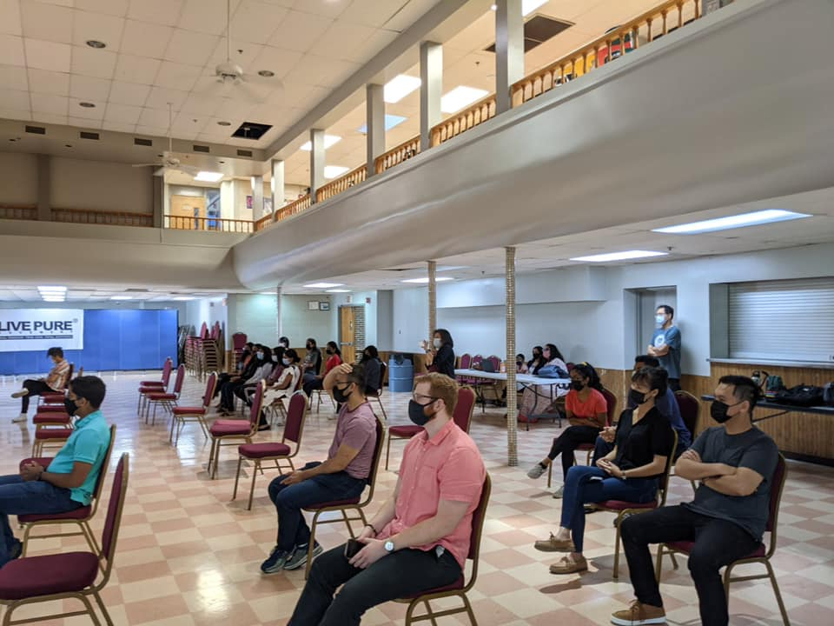
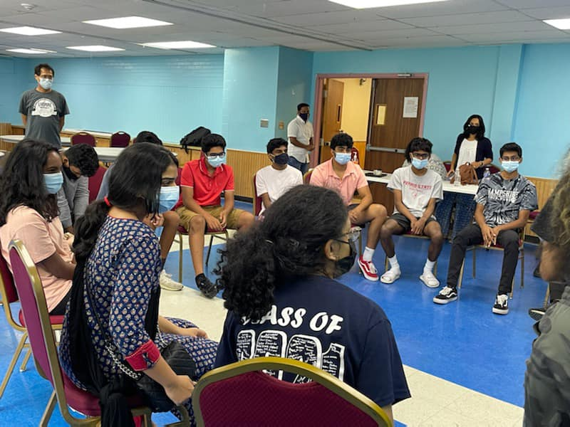
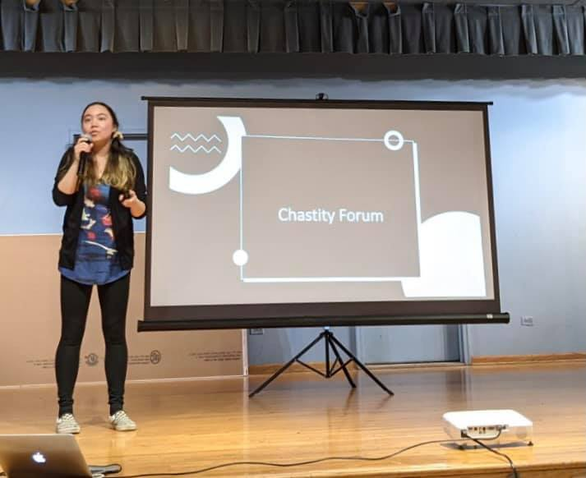
Live Pure at St. Thomas Syro Malabar
Belwood, IL

